Slide 1

AI Academy Apprenticeship Cardiovascular Disease Prediction
By: Daniel Rice, Charles Averill, Leonardo Alvarado, Paola Santamaria, Aaron Zhu

Slide 2
Agenda
1
Business Understanding
2
Client Motivation
3
Modeling Process
4
Results Overview

Slide 3

Cardiovascular Disease in the USA
127.9 million US adults affected from 2017-2020
Yearly Cost: $239.9 billion
-Healthcare Services
-Medicine
-Lost Productivity
*CDC data provided in references
Notes:
Tags: statement, left aligned text, right aligned image, question, image

Slide 4
What is being done about this?
1
Heart Health Screenings
Managing health behaviors and risk factors
Metrics used: blood pressure, cholesterol, body weight, etc.
2
Results Analysis
Doctor's opinion on overall health
Diagnosis made if necessary
3
Machine Learning
Model Innovation
Early warning signs/diagnosis
Increase patient health, reduce costs
DELOITTE CONSULTING LLP
Notes:
Tags: approach, overview, scope, list

Slide 5

Client Motivation
A highly functional machine learning model (MLM) offers a variety of benefits to clients and their stakeholders
Healthcare Institutions
Hospitals, Urgent Care Centers, Virtual Doctors
Insurance Companies
Life Insurance, Health Insurance, Private Insurance
Efficient Screening:
MLM’s can quickly assess a client’s health and risk of heart disease without the need of an appointment
Patient Trust:
Offering multiple “opinions” on client's health allows them to have greater trust in the outcome
Premium Pricing:
Identifying client profiles that are at risk of heart disease allows for premium adjustments
Risk Assessment:
Using this model to assess the risk profile of their client base
Improved Outcomes:
Early detection of heart disease allows clients to get treatment quicker. Identifying at risk individuals can be given health suggestions
Improved Outcomes:
Data driven insights allow for insurance companies to better manage their risk
Notes:
Tags: objectives, vision, approach

Slide 6
Healthcare Institutions
Hospitals, Urgent Care Centers, Virtual Doctors
Client Motivation
A highly functional machine learning model (MLM) offers a variety of benefits to clients and their stakeholders
Efficient Screening:
MLM’s can quickly assess a client’s health and risk of heart disease without the need of an appointment
Patient Trust:
Offering multiple “opinions” on client's health allows them to have greater trust in the outcome
Improved Outcomes:
Early detection of heart disease allows clients to get treatment quicker. Identifying at risk individuals can be given health suggestions
Notes:
Tags: objectives, vision, approach

Slide 7
Insurance Companies
Life Insurance, Health Insurance, Private Insurance
Client Motivation
A highly functional machine learning model (MLM) offers a variety of benefits to clients and their stakeholders
Premium Pricing:
Identifying client profiles that are at risk of heart disease allows for premium adjustments
Risk Assessment:
Using this model to assess the risk profile of their client base
Improved Outcomes:
Data driven insights allow for insurance companies to better manage their risk
Notes:
Tags: objectives, vision, approach

Slide 8
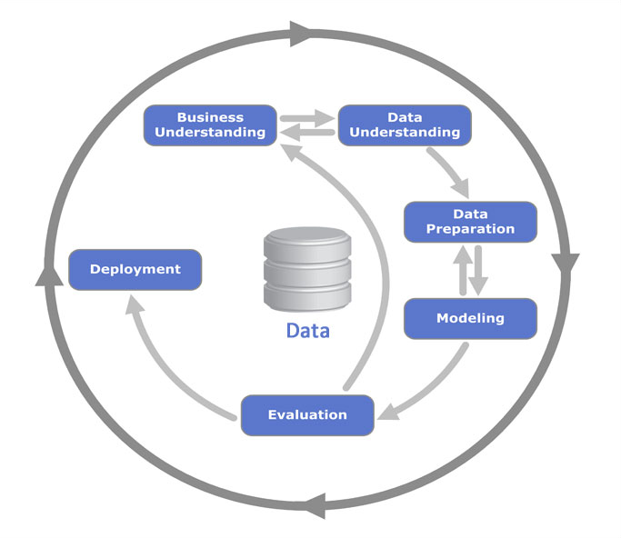
Modeling process

Slide 9
Data Understanding
Situation
Key Factors
Age
Sex
Chest Pain Type: ATA, ASY, NAP
Resting Blood Pressure
Cholesterol
Fasting Blood Sugar
Resting ECG (Electrocardiogram)
Maximum Heart Rate
Exercise Angina
ST Slope
Needing to select reliable and accurate information for each patient
There are several key factors that can indicate a higher risk of developing heart disease
Model should be able to adapt to adding new health factors when improving in the future
Notes:
Tags: approach, objectives, situation, current state

Slide 10
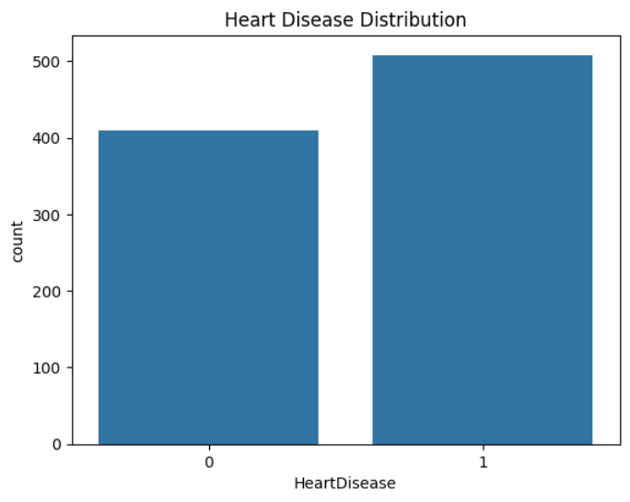
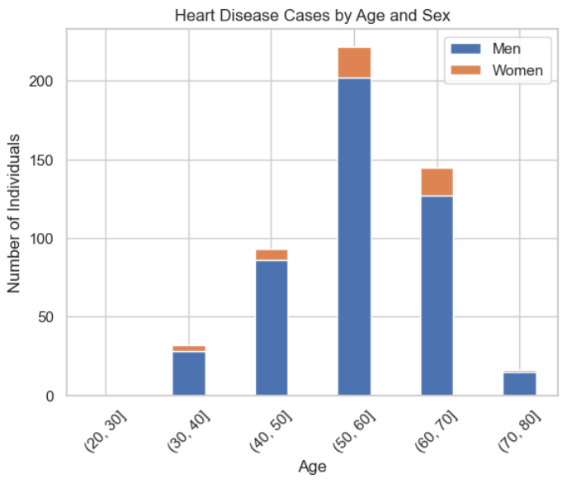
Data Understanding
Notes:
Tags: approach, objectives, situation, current state

Slide 11
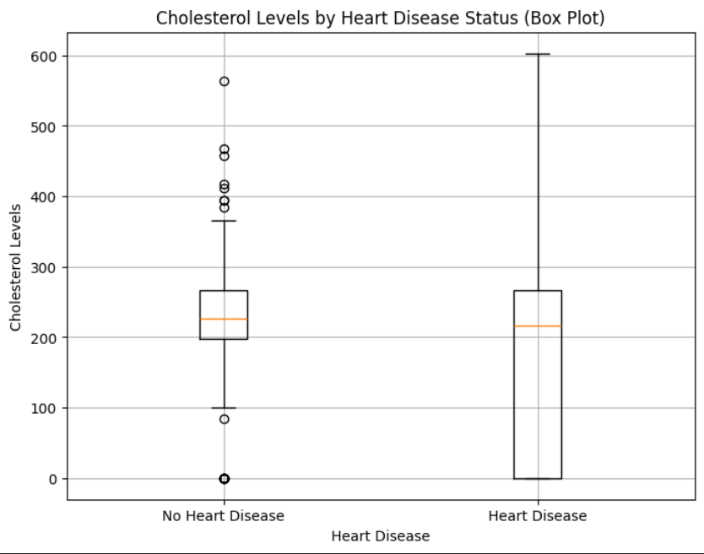
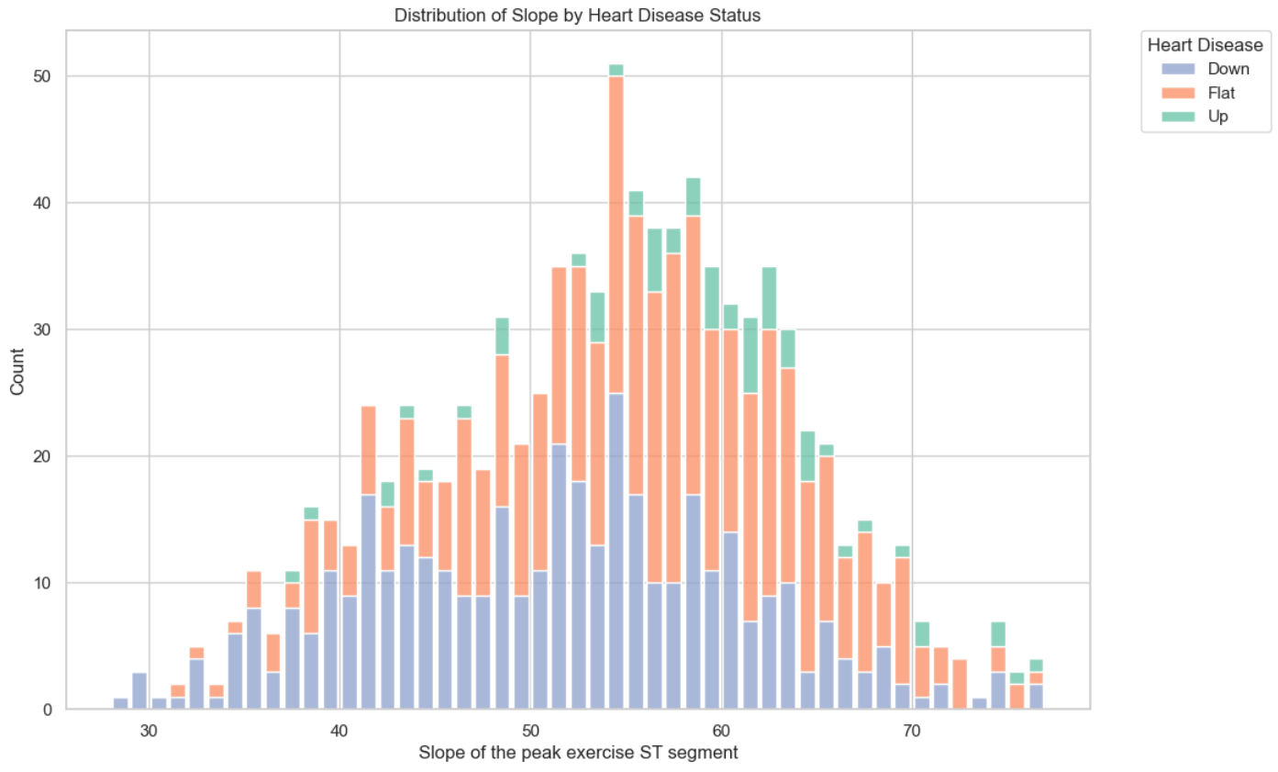
Data Understanding
Notes:
Tags: approach, objectives, situation, current state

Slide 12
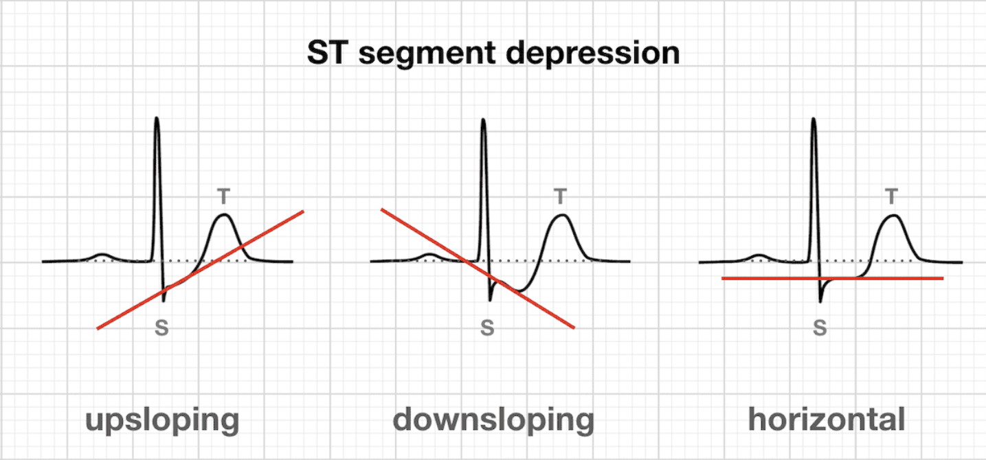
Data Understanding
Notes:
Tags: approach, objectives, situation, current state

Slide 13
Model Selection
After analyzing our data set and business case, we selected FIVE models to run our dataset on. These models were selected to best predict our classification dataset.
LOGISTIC
REGRESSION
Simple to use
Efficiency
Explain the weight of each variable
Easy to understand
NEURAL NETWORK
Non-linearity
Better with high-dimensional data
Performance
Feature Interaction
DECISION TREE
Interpretability
Non-linear Relationships
Feature Importance
Min data Preparation
RANDOM FOREST CLASSIFIER
High Accuracy
Feature Importance
Handling missing data
Scalability
K NEIGHBORS
Simplicity
Non-parametric
Adaptability
Local Patterns
Notes:
Tags: scope, text boxes, icons

Slide 14

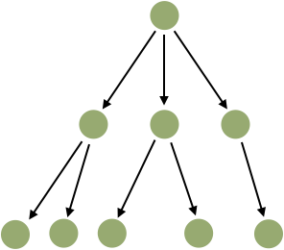
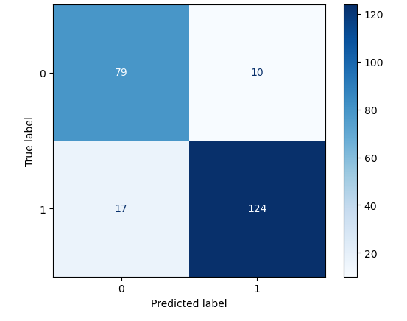
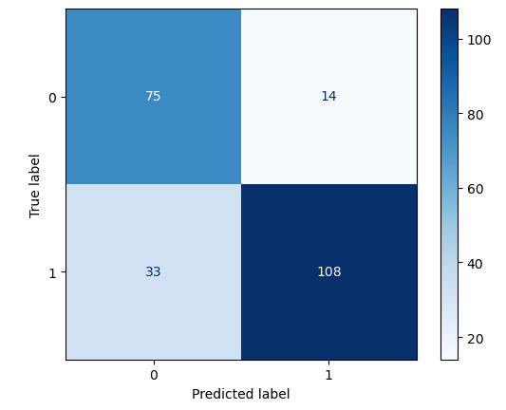
Model Evaluation
Choosing the best model for identifying heart disease is crucial considering the delicacy of the topic. When determining which model is best performing, we narrow our evaluation criteria to a few factors: accuracy, recall, precision, speed, and granularity.
Neural Network
Decision Tree
88% Accuracy, 93% Precision, 88% Recall
Benefit to Scalability
Ability to fit large and complex dataset
80% Accuracy, 89% Precision, 77% Recall
Identify the features that are the biggest contributors to the decision
Speed
Limitation to handle big dataset
Notes:
Tags: text, list, fundamental principles, icons

Slide 15
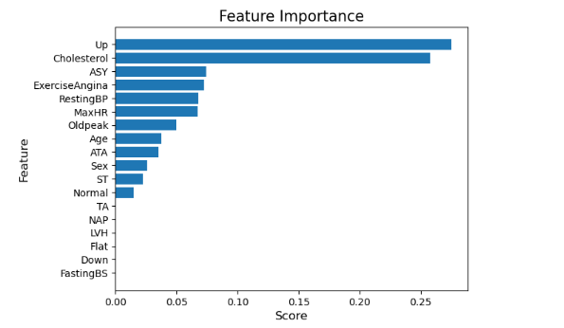
Decision Tree Feature Importance
Understanding which variables are most important in predicting the output: heart disease
#1: Up ST Slope
#2: Cholesterol
#3: Chest Pain Type: ASY

Slide 16
Client Recommendation
1
2
3
Model's business support
Business Impact
Future Recommendations
Expanding model metrics
Patient portal insights
Neural Network and Decision Tree Analysis Combination
High accuracy
Metric insight
Identify patient risk level
Informed decisions on lifestyle changes
Decrease medical costs
Notes:
Tags: text, list, principles

Slide 17
References
2024-Statistics-At-A-Glance-final_2024.pdf (heart.org)
Heart Disease Facts | Heart Disease | CDC
Heart-Health Screenings | American Heart Association
Machine learning-based heart disease diagnosis: A systematic literature review - ScienceDirect

